Slide 1
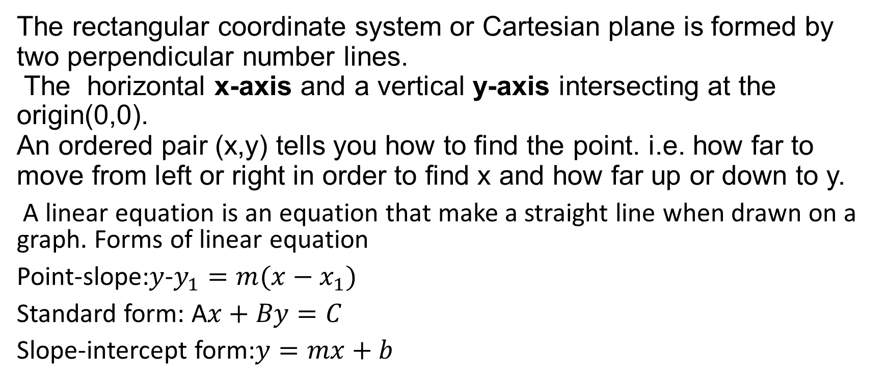
The Rectangular Coordinate System, Slope of a Line and Linear Equations in Two Variables
The rectangular coordinate system or Cartesian plane is formed by two perpendicular number lines.
The horizontal x-axis and a vertical y-axis intersecting at the origin(0,0).
An ordered pair (x,y) tells you how to find the point. i.e. how far to move from left or right in order to find x and how far up or down to y.
A linear equation is an equation that make a straight line when drawn on a graph. Forms of linear equation
Point-slope:$y$-$y_{1}=m(x−x_{1})$
Standard form: A$x+By=C$
Slope-intercept form:$y=mx+b$

Slide 2
1. Explain what the rectangular coordinate system is, including how to interpret an ordered pair(x,y). Then use the coordinate plane to state the quadrant of each point: A(−2,3), B(4,−1), C(0,5), D(−6,−4), E(3,0).
The axes divide the plane into 4 quadrants.
A(−2,3): (negative x, positive y)= quadrant II
B(4,−1): (positive x, negative y)= quadrant IV
C(0,5): x=0,lies on the y-axis=No quadrant
D(−6,−4): (negative x, negative y)= quadrant III
E(3,0): y=0,lies on the x-axis=No quadrant
QUADRANT | CORDINATE
Quadrant I | (+,+)
Quadrant II | (-,+)
Quadrant III | (-,-)
Quadrant IV | (+,-)

Slide 3
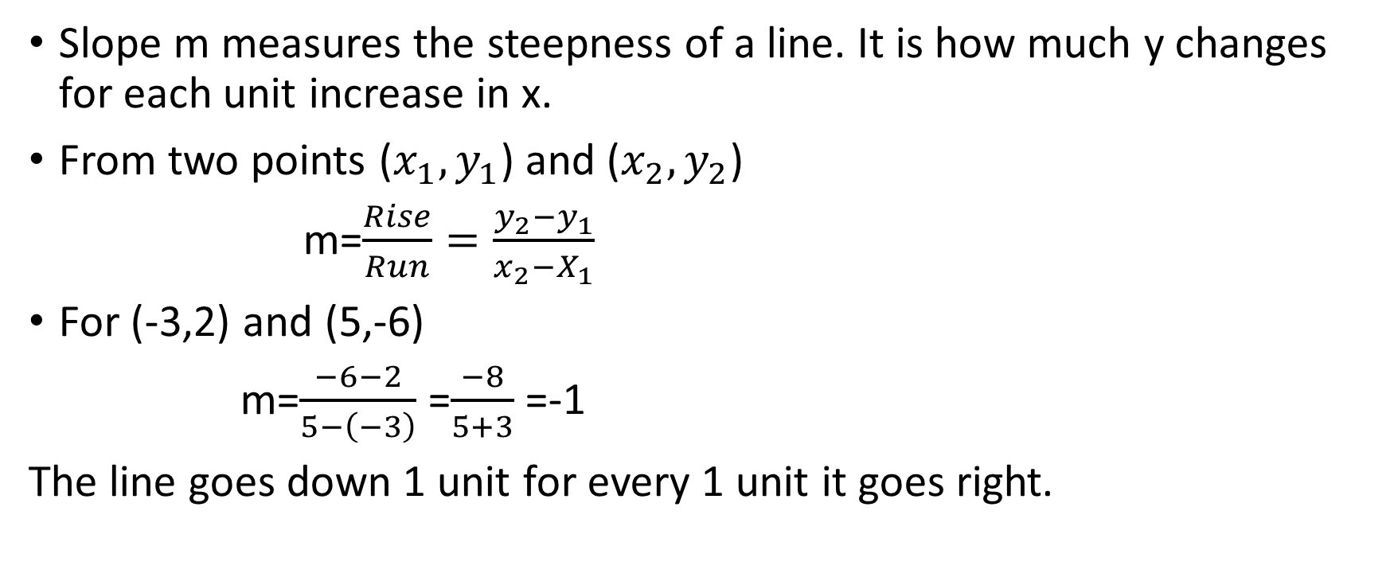
2. Explain how slope measures how much y changes when x changes, and how to determine slope from two points on a line (e.g., using the rise-over-run idea). Then find the slope of the line through:(−3,2) and (5,−6).
Slope m measures the steepness of a line. It is how much y changes for each unit increase in x.
From two points ($x_{1},y_{1}$) and ($x_{2},y_{2}$)
m=$\frac{Rise}{Run}=\frac{y_{2}−y_{1}}{x_{2}−X_{1}}$
For (-3,2) and (5,-6)
m=$\frac{−6−2}{5−\left(−3\right)}$ =$\frac{−8}{5+3}$ =-1
The line goes down 1 unit for every 1 unit it goes right.

Slide 4
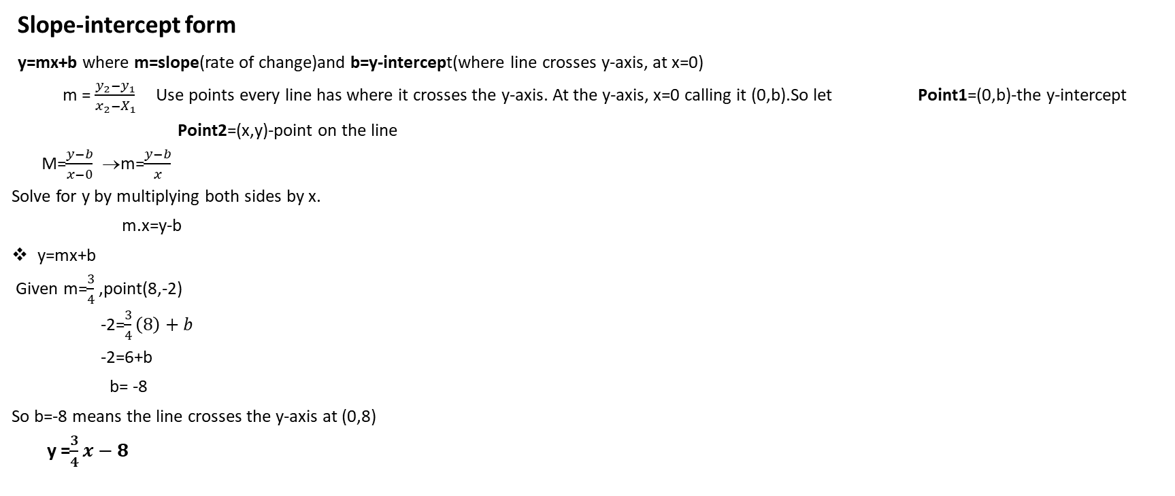
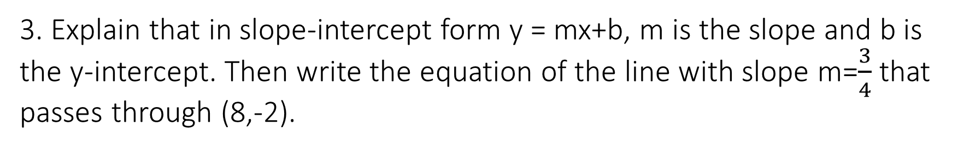
3. Explain that in slope-intercept form y = mx+b, m is the slope and b is the y-intercept. Then write the equation of the line with slope m=$\frac{3}{4}$ that passes through (8,-2).
Slope-intercept form
y=mx+b where m=slope(rate of change)and b=y-intercept(where line crosses y-axis, at x=0)
m = $\frac{y_{2}−y_{1}}{x_{2}−X_{1}}$Use points every line has where it crosses the y-axis. At the y-axis, x=0 calling it (0,b).So let Point1=(0,b)-the y-intercept
Point2=(x,y)-point on the line
M=$\frac{y−b}{x−0}$ →m=$\frac{y−b}{x}$
Solve for y by multiplying both sides by x.
m.x=y-b
y=mx+b
Given m=$\frac{3}{4}$ ,point(8,-2)
-2=$\frac{3}{4}\left(8\right)+b$
-2=6+b
b= -8
So b=-8 means the line crosses the y-axis at (0,8)
y =$\frac{3}{4}x−8$

Slide 5
4. Explain what it means for a point (x,y) to satisfy a linear equation in two variables. Then:
(a) Determine whether (2,−3) satisfies 2x + 3y = −5.
(b) If it does not satisfy, find one point (x,y) that does satisfy the equation
A point (x,y) satisfies a linear equation if substituting its coordinates into the equation results in a true mathematical statement.
Given 2x+3y=−5:
(a) Check (2,−3):
Substitute the values,
2(2)+3(-3)=→ 4-9= -5
-5=-5 is True, so yes it satisfies the equation
(b)Since it does satisfy, another valid point can still be found by choosing a value like x=5
2(5)+3y=-5 →10+3y=-5→3y=-15→y=-5
Points such as (2,−3) and (5,−5) satisfy the equation

Slide 6
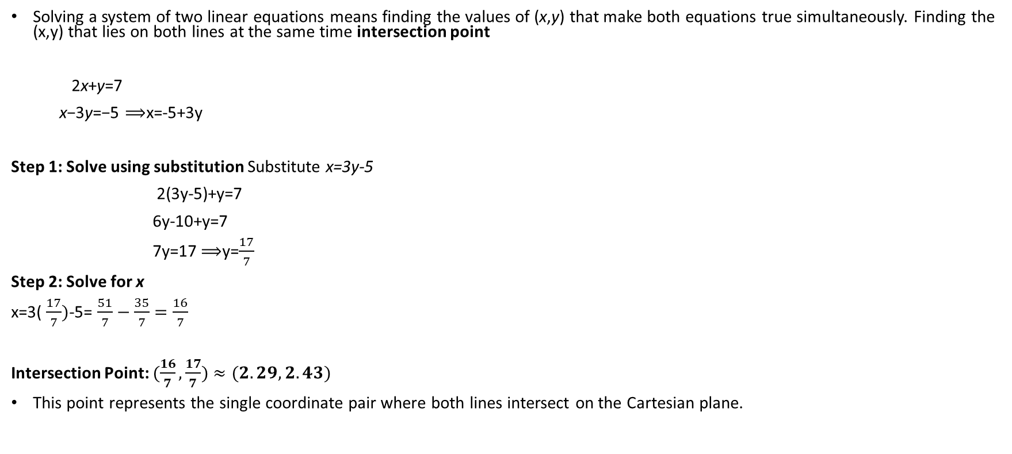
5. Explain how solving a system of two linear equations works . Then solve the system and state the intersection point: 2x + y = 7 & x − 3y = −5 and interpret the result as the intersection point of two lines.
Solving a system of two linear equations means finding the values of (x,y) that make both equations true simultaneously. Finding the (x,y) that lies on both lines at the same time intersection point
2x+y=7
x−3y=−5 ⟹x=-5+3y
Step 1: Solve using substitution Substitute x=3y-5
2(3y-5)+y=7
6y-10+y=7
7y=17 ⟹y=$\frac{17}{7}$
Step 2: Solve for x
​x=3( $\frac{17}{7})$-5= $\frac{51}{7}−\frac{35}{7}=\frac{16}{7}$
Intersection Point: $(\frac{16}{7},\frac{17}{7})≈(2.29,2.43)$
This point represents the single coordinate pair where both lines intersect on the Cartesian plane.

